Slide 1
An introduction to
Beyond Budgeting
Agile Tour Vienna, 12 September 2024
Bjarte Bogsnes
Chairman Beyond Budgeting Roundtable
Founder Bogsnes Advisory

Slide 2

The illusion of control
The definition
“The power to influence or direct people's behaviour or the course of events”
The grand illusion
People can and must be managed
The future is predictable and manageable
In business terms
Controlling people
Controlling the future

Slide 3



Slide 4


«Most of what we call management is about making it difficult for people to do their job»
Peter Drucker

Slide 5
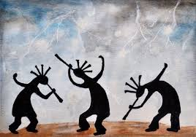
“Most corporate planning is like a ritual rain dance. It has no effect on the weather, but those who engage in it think it does. Much of the advice and instruction is directed at improving the dancing, not the weather” - Russel L. Ackoff

Slide 6
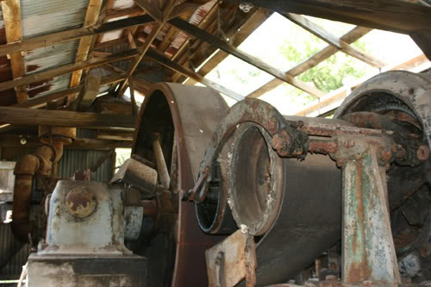

Slide 7
The innovation paradox
Technology innovation
Management innovation
Leading edge!
Unique!
Forefront!
- a very crowded place
- not yet a crowded place
Great!
Scary!
Same purpose: Better performance!

Slide 8









Budget problems
Very time consuming
Assumptions quickly outdated
Stimulates unethical behaviours
Creates illusions of control
Decisions made too early and often too high up
Can prevent value adding activities
Not just a ceiling for cost, also a floor
Often a bad yardstick for evaluating performance
Conflicting purposes
Irritating itches - or symptoms of a bigger problem?

Slide 9

Managing traffic performance
- one alternative
Who is in control?
Based on which information?

Slide 10
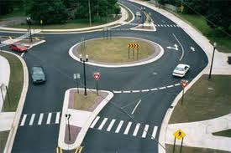
Managing traffic performance - another alternative
Who is in control?
Based on which information?

Slide 11

Which is most difficult?
Which is most efficient?
In which are values most important?

Slide 12
The world has changed
– what about the way we lead and manage?
Business environment
Dynamic
Traditional
management
Stable
”Theory X”
”Theory Y”
People

Slide 13
We must change both processes and leadership
Processes
Beyond Budgeting
- more adaptive
- more human
No traditional detailed budgets
Relative and directional goals
Dynamic planning, forecasting and resource allocation
Holistic performance evaluation
Dynamic
Rigid, detailed and annual
Rules-based micro management
Centralised command and control
Secrecy, sticks and carrots
Purpose and values based
Autonomy
Transparency
Internal motivation
Stable
”Theory X”
”Theory Y”
Leadership

Slide 14
Beyond Budgeting
Performance. The Right Way.
Leadership principles
1. Purpose - Engage and inspire people around bold and noble causes; not around short-term financial targets
2. Values - Govern through shared values and sound judgement; not through detailed rules and regulations
3. Transparency - Make information open for self-regulation, innovation, learning and control; don’t restrict it
4. Autonomy - Trust people with freedom to act; don’t punish everyone if someone should abuse it
5. Organisation - Cultivate a strong sense of belonging and organise around accountable teams; avoid hierarchical control and bureaucracy
6. Customers - Connect everyone’s work with customer needs; avoid conflicts of interest
Management processes
7. Targets - Set directional, ambitious and relative goals; avoid fixed and cascaded targets
8. Forecasts - Make forecasting a lean and unbiased process; not a rigid and political exercise
9. Resource allocation - Foster a cost conscious mind-set. Plan and make resources available as needed; not through detailed annual budget allocations
10. Performance evaluation - Evaluate performance holistically to guide interventions; not based on measurement only and not for rewards only
11. Rewards - Reward shared success against competition; not against fixed performance contracts
12. Coordination - Organise management processes dynamically around business rhythms and events; not around the calendar year only

Slide 15















































































































15
Companies on the journey
Notes:
The Leader's Dilemma
5 October 2011
© BBRT 2011 - All rights reserved
15

Slide 16
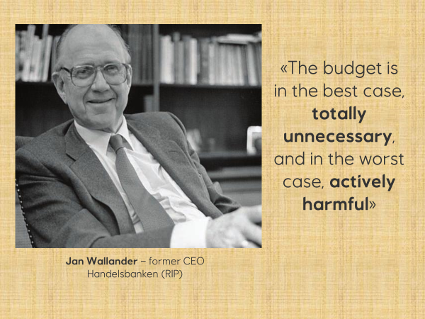

Slide 17



Getting started - solving the budget conflict
Budget purposes
1. Separate
2. Improve
Target
An aspiration - what we want to happen
Inspiring & stretching
Relative where possible
Basis for performance evaluation
Target
Forecast
Resource allocation
Forecast
An expectation – what we think will happen
Unbiased - expected outcome
Not a promise
Limited detail
Resource allocation
Optimization of scarce resources
More continuous allocation
KPI targets, mandates, decision
gates and decision criteria
Trend monitoring
Same number Conflicting purposes
Different numbers
Different processes
More event driven
Less calendar driven

Slide 18
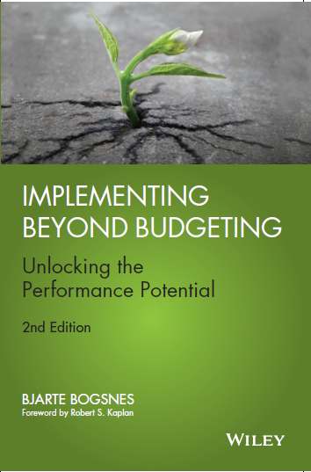
Want to hear more?
The problems with traditional management
The Beyond Budgeting model
  Cases: Handelsbanken, Miles, Reitangruppen
The Borealis case
The Statoil case
Beyond Budgeting and Agile
Implementation advice
Wiley (US). Translated to German, Chinese, Japanese and Russian
"At last, Bjarte Bogsnes has made his experience and enthusiasm for Beyond Budgeting available for a wider audience with this remarkable book. I have appreciated his engagement in these important management issues for many years, and his knowledge and leadership has been critical in the transformation of our organization.“
-Eldar Sætre, former CEO Equinor

Slide 19
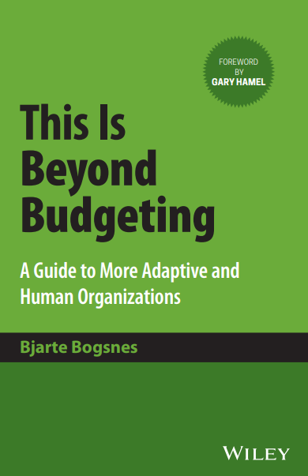
Just out
Foreword by Gary Hamel

Slide 20
Beyond Budgeting Masterclasses
25-26 November, Copenhagen
23-24 september, Oslo
20-21 november, Oslo

Slide 21

Questions or comments - now or later?
bjarte@bogsnesadvisory
Twitter @bbogsnes
LinkedIn
Beyond Budgeting Round Table (bbrt.org)
bogsnesadvisory.com

